Slide 1
Modernization Road Map - Navisysfo
June 2019

Slide 2
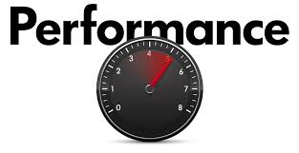


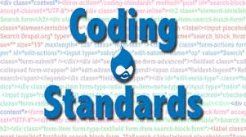




Agenda

Slide 3














Road Map
Implemented
Currently WIP / YTBD (Yet To Be Decided)

Slide 4




Road Map - Interfaces
Mobile App – interface cycle and other notifications
Dashboard for Orders / Money / Transaction
To create Confluence page for data level mapping and extraction information
Pershing Refresh
Agent Setup
Post Production Validation
Archival Redesign – Audit Compliance & Data Integrity
Chat Bot
Implementing Server less Environment
Implemented
Currently WIP / YTBD (Yet To Be Decided)

Slide 5
Benefits achieved through GitHub & Jenkins Implementation
Process Improvement | Before GitHub | After GitHub
Collaboration | Happens only during Integration Phase | Happens everyday. Best Suits Agile practice
Release Notes (Documentation) | Manual Preparation | Documentation made easy. GitHub Prepares release notes automatically which reduces time & effort of developers.
Track Code Changes | Tedious & Manual | Easy & revisions maintained by itself
Jenkins CI / CD Integration | Not Available | Build automation Build versioning by JFrog Artifactory Build & it’s log validation made easy Build performance Visibility
Code Setup | Tedious & complex for new comers. Every developer was having different code base & older versions. | Easy to Setup. Every Developer works with latest code base
CM Team Dependency for DEV-INT | Additional process Overhead | Reduced to 0%.
Eclipse Integration | Not Available due to the lack of PVCS IDE plugin | Git Eclipse plugin made code commit & Push made easy.

Slide 6
Benefits achieved through Selenium Automation
Process Improvement | Before Selenium Automation | After Selenium Automation
Time to Test | More Time taken even for single test case Since Manual | Less Time & effort consumption even for Multiple Test Cases.
Data Driven | Not Available | Data Driven made easy. Business users can just put in their inputs & Test Cases in Excel & Run the scripts.
Event Driven | Not Available | Yet to be decided
Test Case Report | Not Available | Excel based reporting Records error snap shots Keeps track of both +ve & -ve cases
Regression | Manual | Made Easy
Mailing Alert | Not Available | Work In Progress. Implemented soon

Slide 7
Benefits achieved through SonarQube/Scanner & Lint
Process Improvement | Before Sonar Lint | After Sonar Lint
Coding Standard | Developer identifies the standards bug at last | Developer identifies the bugs, vulnerabilities while typing each and every line itself. So that he can correct it on-the-fly.
Reviewer Effort | Reviewer hast to put in more effort to identify standards bugs & Vulnerability | Reviewer effort & cost reduced in checking Coding Standards. Reviewer can concentrate only on Business Requirement validation on Code.
Technical Debts | Tedious for Lead / Managers to identify hours required to clear bugs & Vulnerabilities. | Easy to identify hours required to fix standards related issues.
Developer Guidance | Not Available | Code Compliance guide available
Eclipse Plugin | N/A | Available

Slide 8
Benefits achieved through Security Vulnerability Checks By Veracode
Implementation | Before Veracode | After Veracode
Vulnerabilities | Existed Vulnerabilities (Very High, High & Medium) XSS – Cross Site Scripting CSRF – Cross Site Request Forgery SQL Injection "Carriage Return" and "Line Feed." | Cleared all Very High, High & Medium Vulnerabilities
Score | Scan Score : 35 | AppScan Score Improved as follows. Mar Release Score : 73 April Release Score : 75 June Release Score : 100
SSL | Not Implemented | Implemented Fixed Back Button issue in Production in navisysfo Fixed ajax utility issue in Sunview

Slide 9

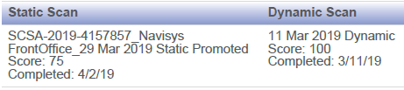
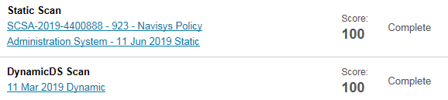
Veracode Report
March Release
April Release
June Release

Slide 10
Road Ahead…
Implementation | Purpose of Implementation
Code Profiling (Visual VM) | Identify Memory Leaks
Asynchronous Loggers | Performance Tuning Measure upon loggers
Code Minification | Performance Tuning Measure upon CSS, JavaScript & HTML pages.

Slide 11
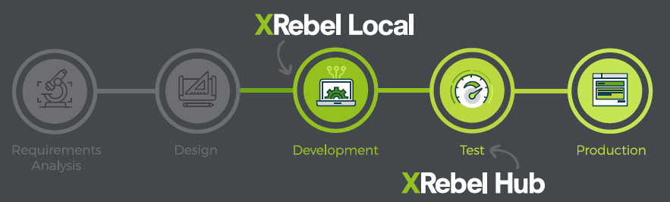
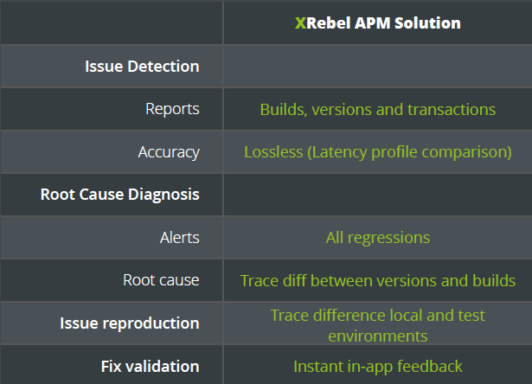
XRebel- APM

Slide 12
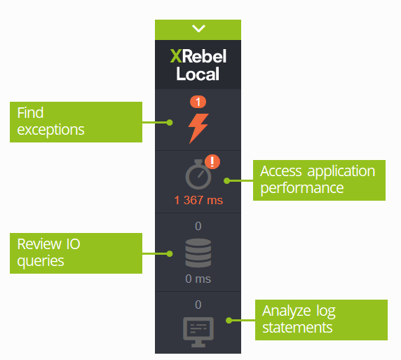
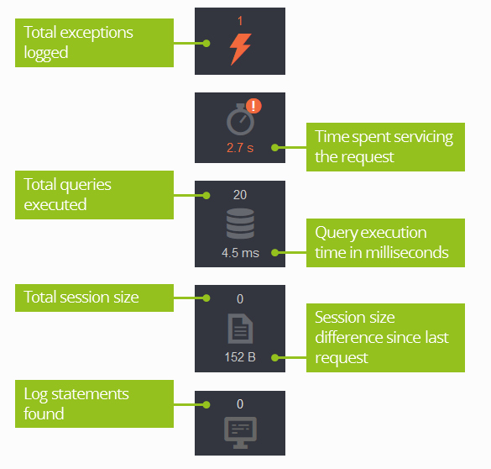
XRebel- APM

Slide 13
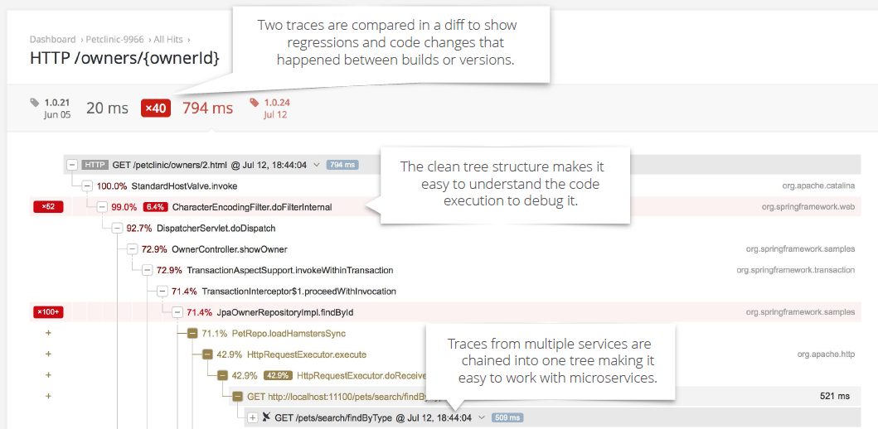
Xrebel APM Trace / Call Graph

Slide 14
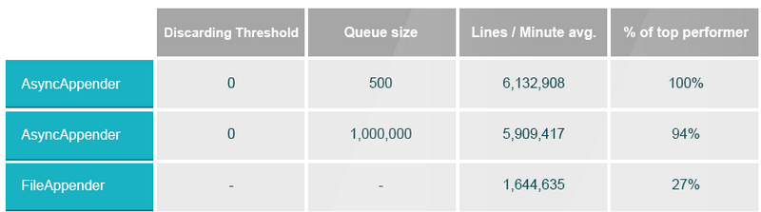
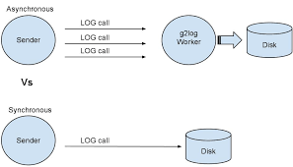
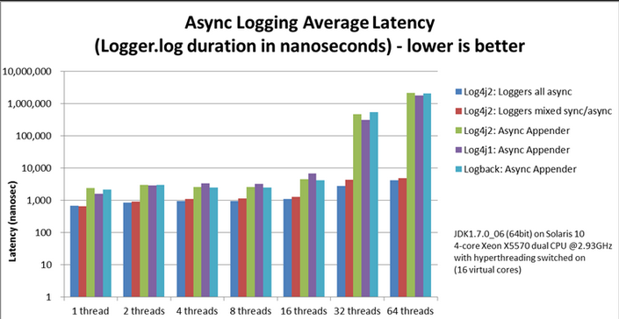
Asynchronous Loggers

Slide 15
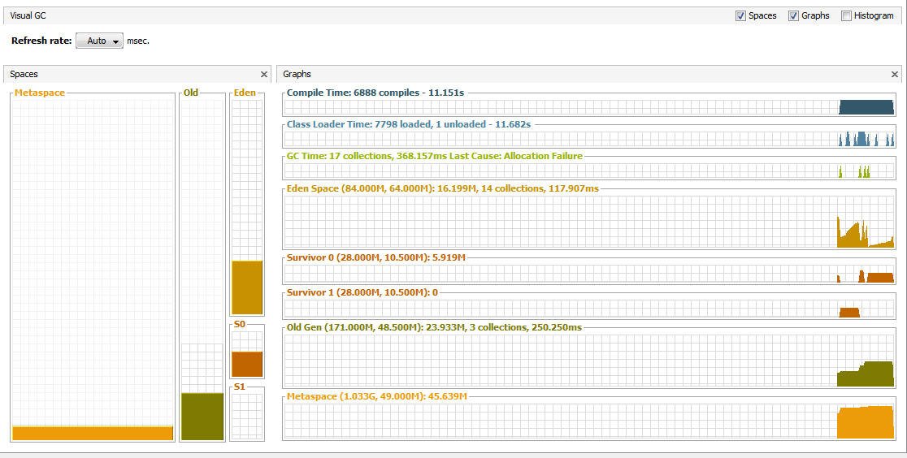
Visual VM

Slide 16
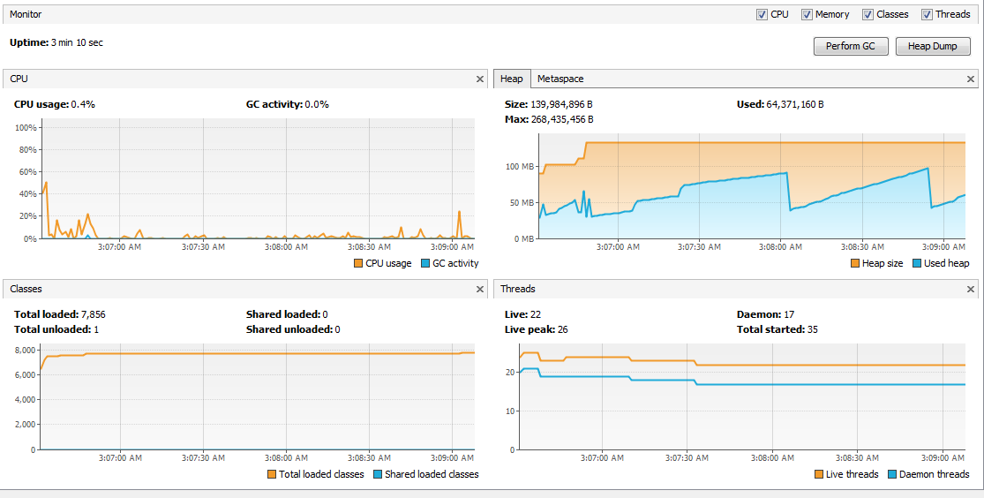
VisualVM

Slide 17
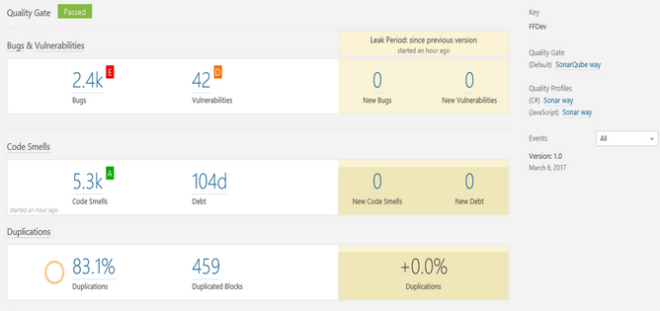
SonarQube

Slide 18
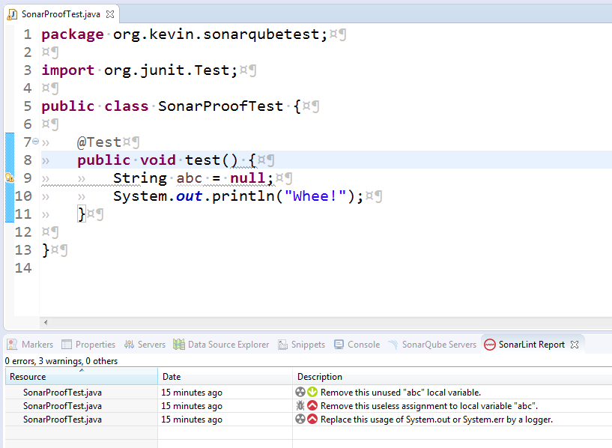
SonarLint

Slide 19
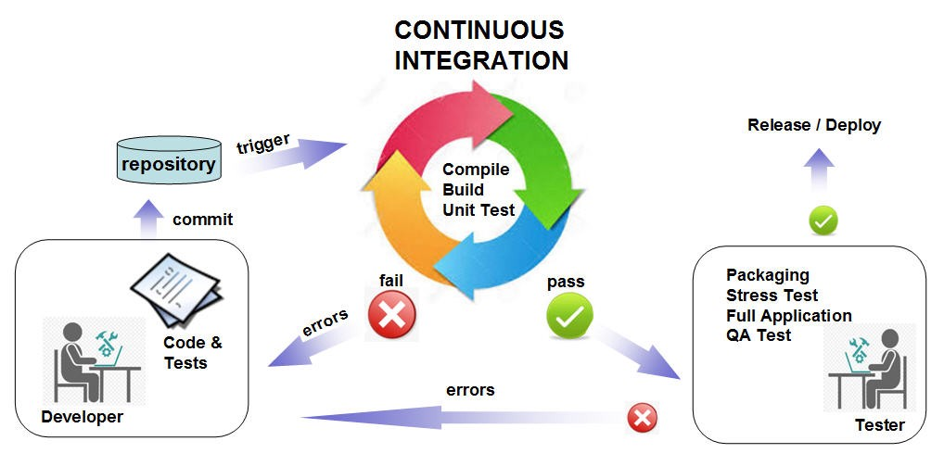
Jenkins

Slide 20
GzipFilter
Implementation Details:
Existing ServletFilter.java needs to be updated with GZip Filter code (few lines of code)
Need to add 2 more new .Java files for Response Wrapping with Compressed encoding.
Servlet Filter Mapping has to be added for .JSP, >JS, .CSS & .HTML
That’s it!

Slide 21
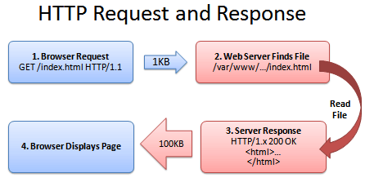
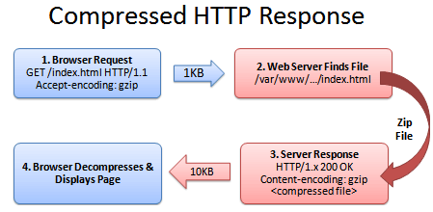
GZipFilter
About GZip Filter :
It is a normal Servlet Filter
Can be implemented in Web Application Framework Level
It Compress the HttpRequests & HttpResponses in perspective of reducing Web Page Load time.
It does Compression over JSPs, .JS, .CSS & .HTML
This Compression is nothing but minification measure to increase Page Speed
As a part of our Navisys-fo application performance improvisation we have tested GZip Filter local which gives a huge & +ve delta change in performance.
It gives more than 50% improvisation in performance on an average.
Implementation Plan is Work In Progress
Normal
GZip

Slide 22
THANK YOU

